Slide 1
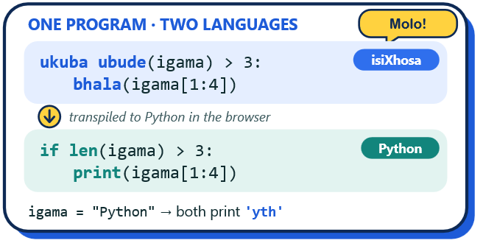


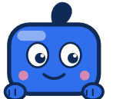





UCT HONOURS 2026
STRING
>>>
English/isiXhosa
Pedagogical localisation
CONUNDRUM
Why did my code do that?
Learn Python strings through visualisation, targeted feedback and isiXhosa localisation.
01
THE PROBLEM
OBJECTIVE
02
Strings are a fundamental data type used throughout programming, yet novice programmers can struggle to understand how they behave. String Conundrum was developed to support students in overcoming these difficulties through visualisation, practice and misconception-targeted feedback.
Develop an interactive web-based platform that helps novice programmers learn Python strings through visualisation, practice, misconception-targeted feedback and English/isiXhosa learning support.
VISUALISE
FEEDBACK
LOCALISE
03
STRING VISUALISER
Index
0
1
2
3
4
5
6
7
8
9
10
11
12
Hi! I’m the comma at index 5.
Stop is excluded, so am I!
-13
-12
-11
-10
-9
-8
-7
-6
-5
-4
-3
-2
-1
Char
H
e
l
l
o
,
␣
W
o
r
l
d
!
Start: 1
Stop: 5
(inclusive)
(exclusive)
The String Visualiser turns Python string operations into interactive, step-by-step explanations. Learners can explore indexing and slicing using character highlighting, positive and negative indices, and narrated explanations of how Python produces each result. See the operation. Follow the indices. Understand the result.
04
CODE SPACE
FEEDBACK
05
Code Space provides an editor and execution surface independent of the module sequence, reachable without an account.
Submitted code is sandboxed with a five-second limit and a 200-step tracer cap; a transpile control converts the editor’s contents into isiXhosa keyword form.
It returns output only, performing no grading.
Incorrect answers can be linked to known string misconceptions. Instead of only marking an answer wrong, String Conundrum explains the likely mistake and shows a worked visual example. Practice includes multiple-choice, select-all, short-answer and code-writing questions. New questions can be generated from templates, while weak areas are linked back into practice.
06
EVALUATION AND RESULTS
Three target-user evaluation cycles (n = 11, 11, 13) · expert review · peer developer evaluation · UAT
Usability (SUS)
Applied knowledge (% fully correct)
KEY FINDINGS
100
Indexing
94%
Usability (SUS). Scores remained similar despite differences in participant population and evaluation context.
Applied knowledge. In Cycle 2, indexing, slicing, and comparison each reached 100% fully correct.
80
Comparison
91%
60
Slicing
86%
40
C1: 79.2
C2: 82.5
C3: 79.8
Immutability
57%
CONCLUSION String Conundrum makes Python string behaviour visible, explains misconceptions and supports English/isiXhosa learning. Evaluation showed positive usability and immediate understanding of core concepts.
University of Cape Town
Department of Computer Science
Hlomla Kuhlane · Luvuyo Matomela
khlhlo002@myuct.ac.za
mtmluv001@myuct.ac.za
Supervisors
Aslam Safla: asafla@cs.uct.ac.za
Live: string-1.cs.uct.ac.za

